Slide 1
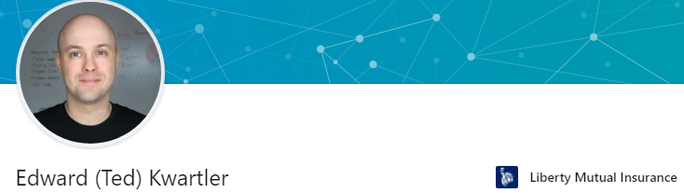








https://www.linkedin.com/in/edwardkwartler/
Side Hustles

Slide 2



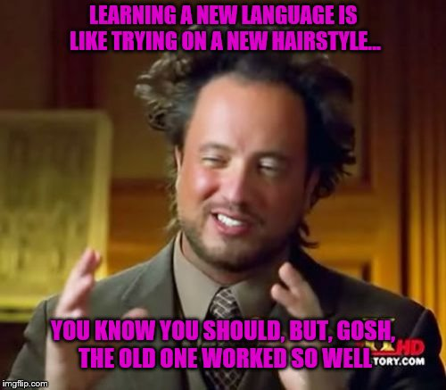

If you are struggling ask for help.

Slide 3
The course uses three software components for learning.
In the next sections, skip to the method you want to use Local (Mac or Windows, Virtual Machine, Cloud/Hosted)
Integrated Development Environment
Version Control & file sharing
Statistical Software

Slide 4
2 Options for R, Rstudio & git
Local Laptop
Cloud
OS:
Mac
Linux/Ubuntu
Windows
OS:
Linux/Ubuntu is most popular
You can use a free account at www.rstudio.cloud for the course.

Slide 5
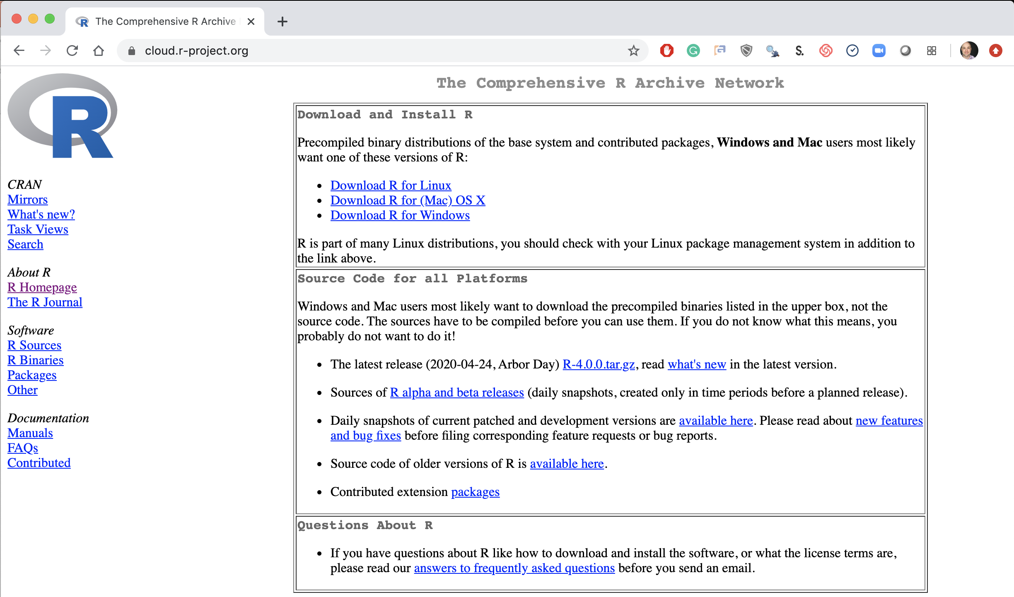
Step 1. Install Base -R
Local Laptop – Windows or Mac
Download the appropriate version Linux, Mac or Windows.
https://cloud.r-project.org/

Slide 6
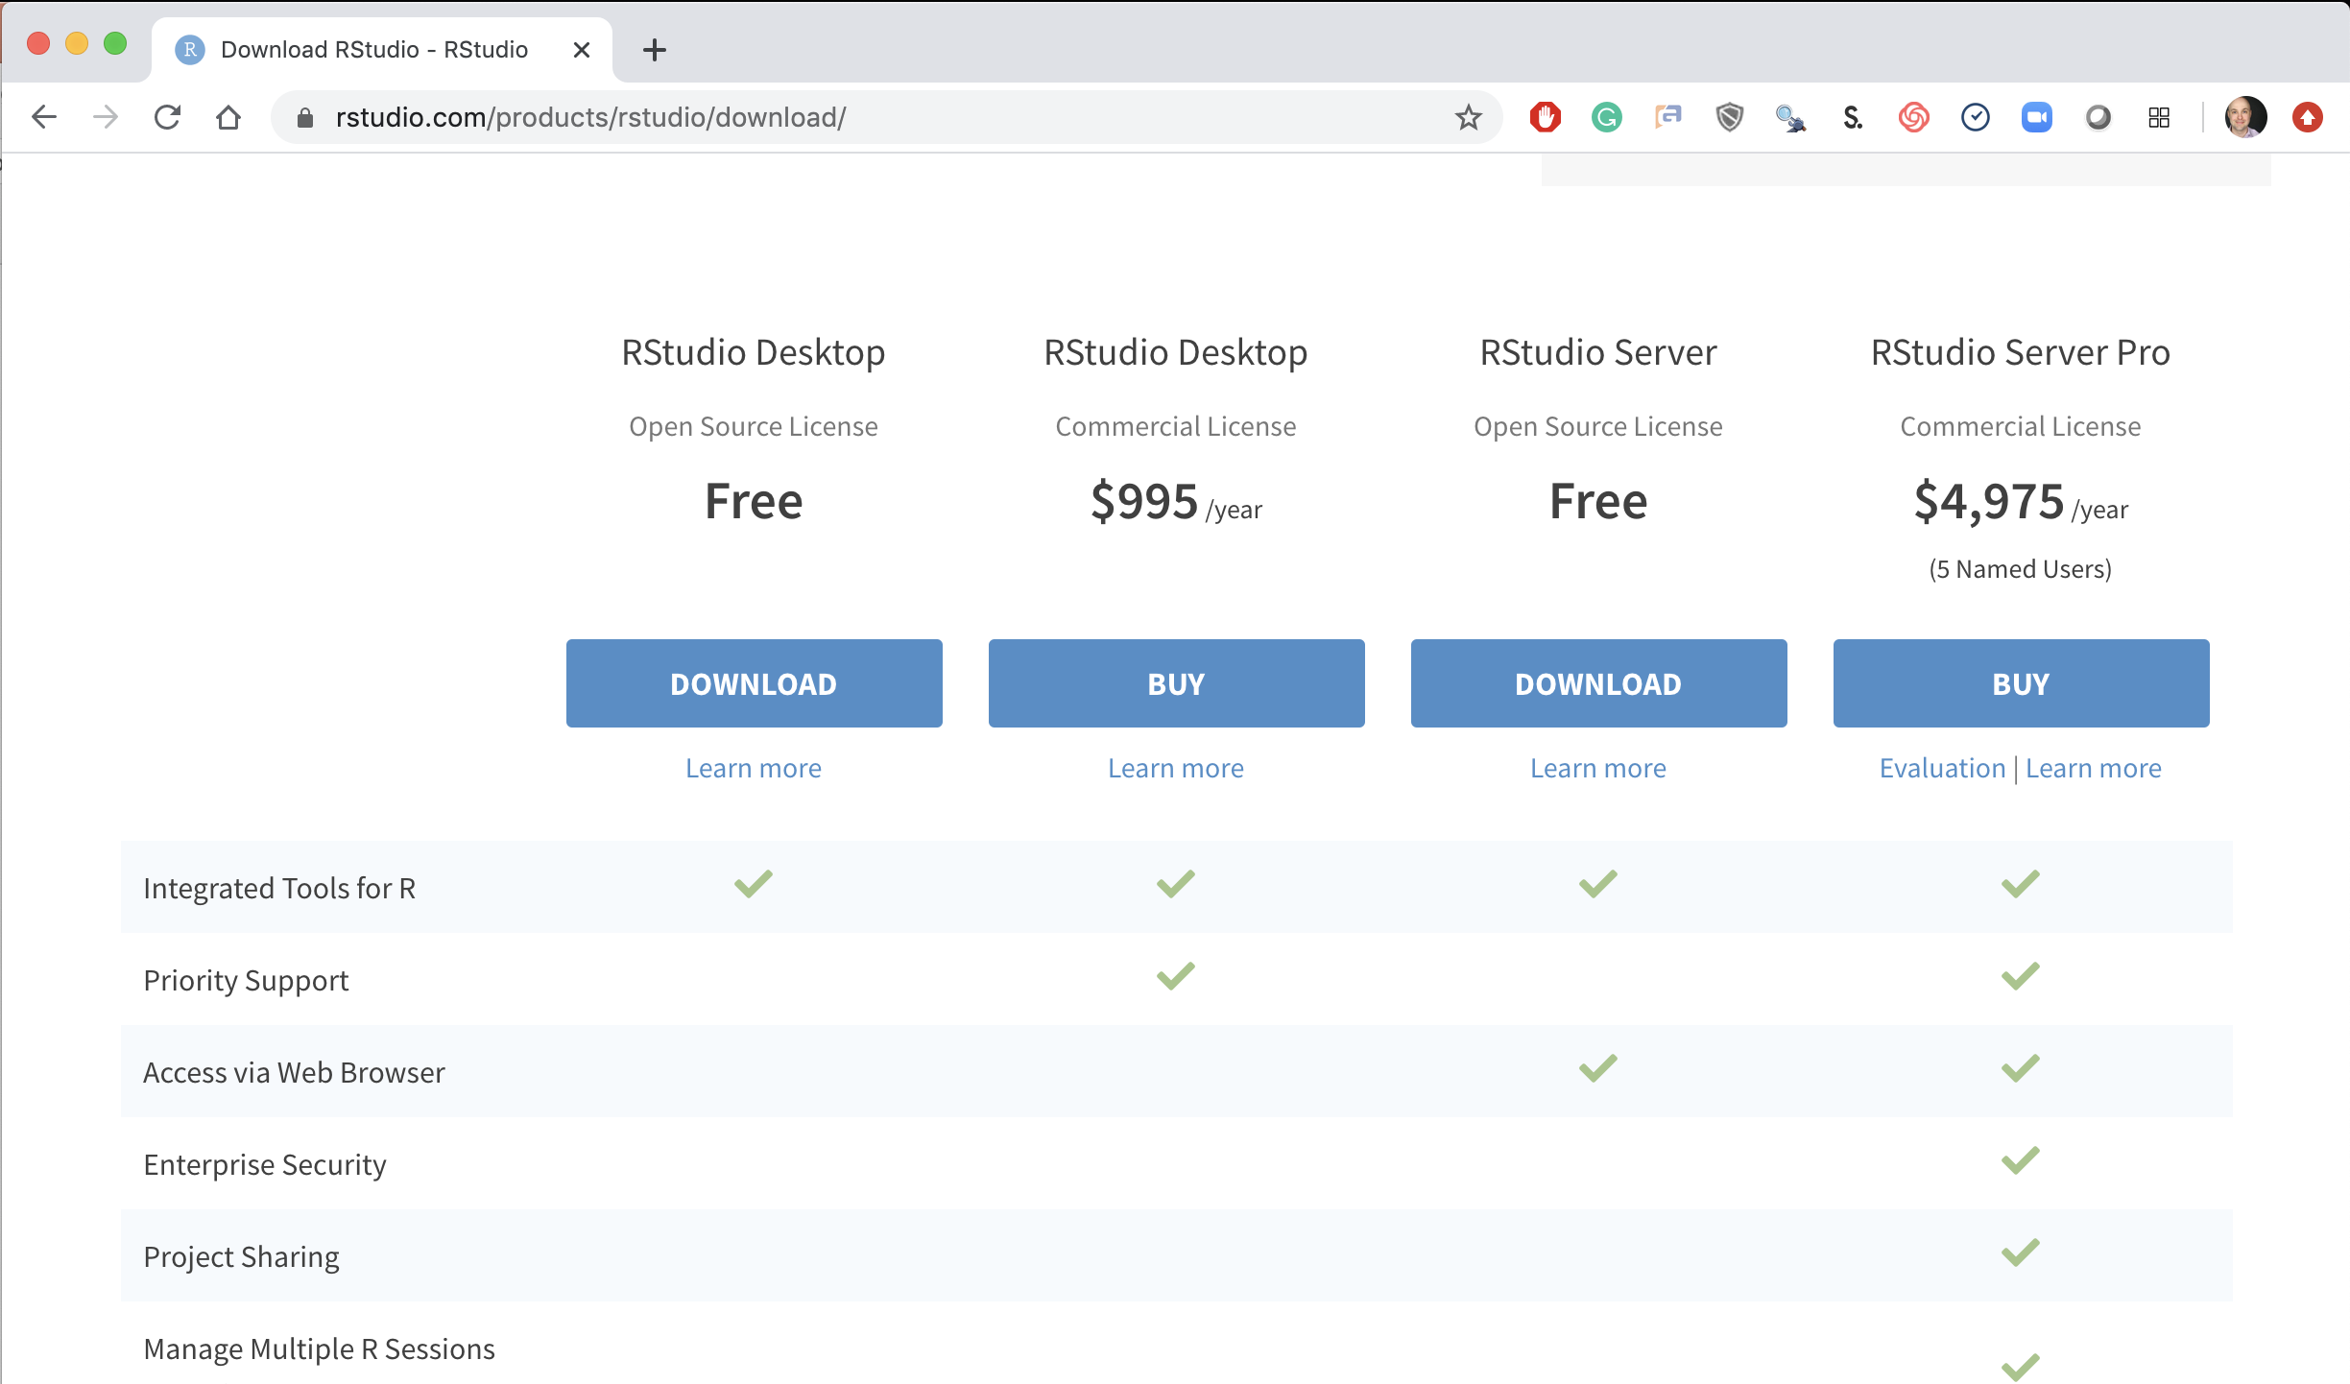
Step 2. Install R-Studio
Local Laptop Windows or Mac
Download the R Studio Desktop (Free).
https://rstudio.com/products/rstudio/download/ &
https://rstudio.com/products/rstudio/download/#download

Slide 7
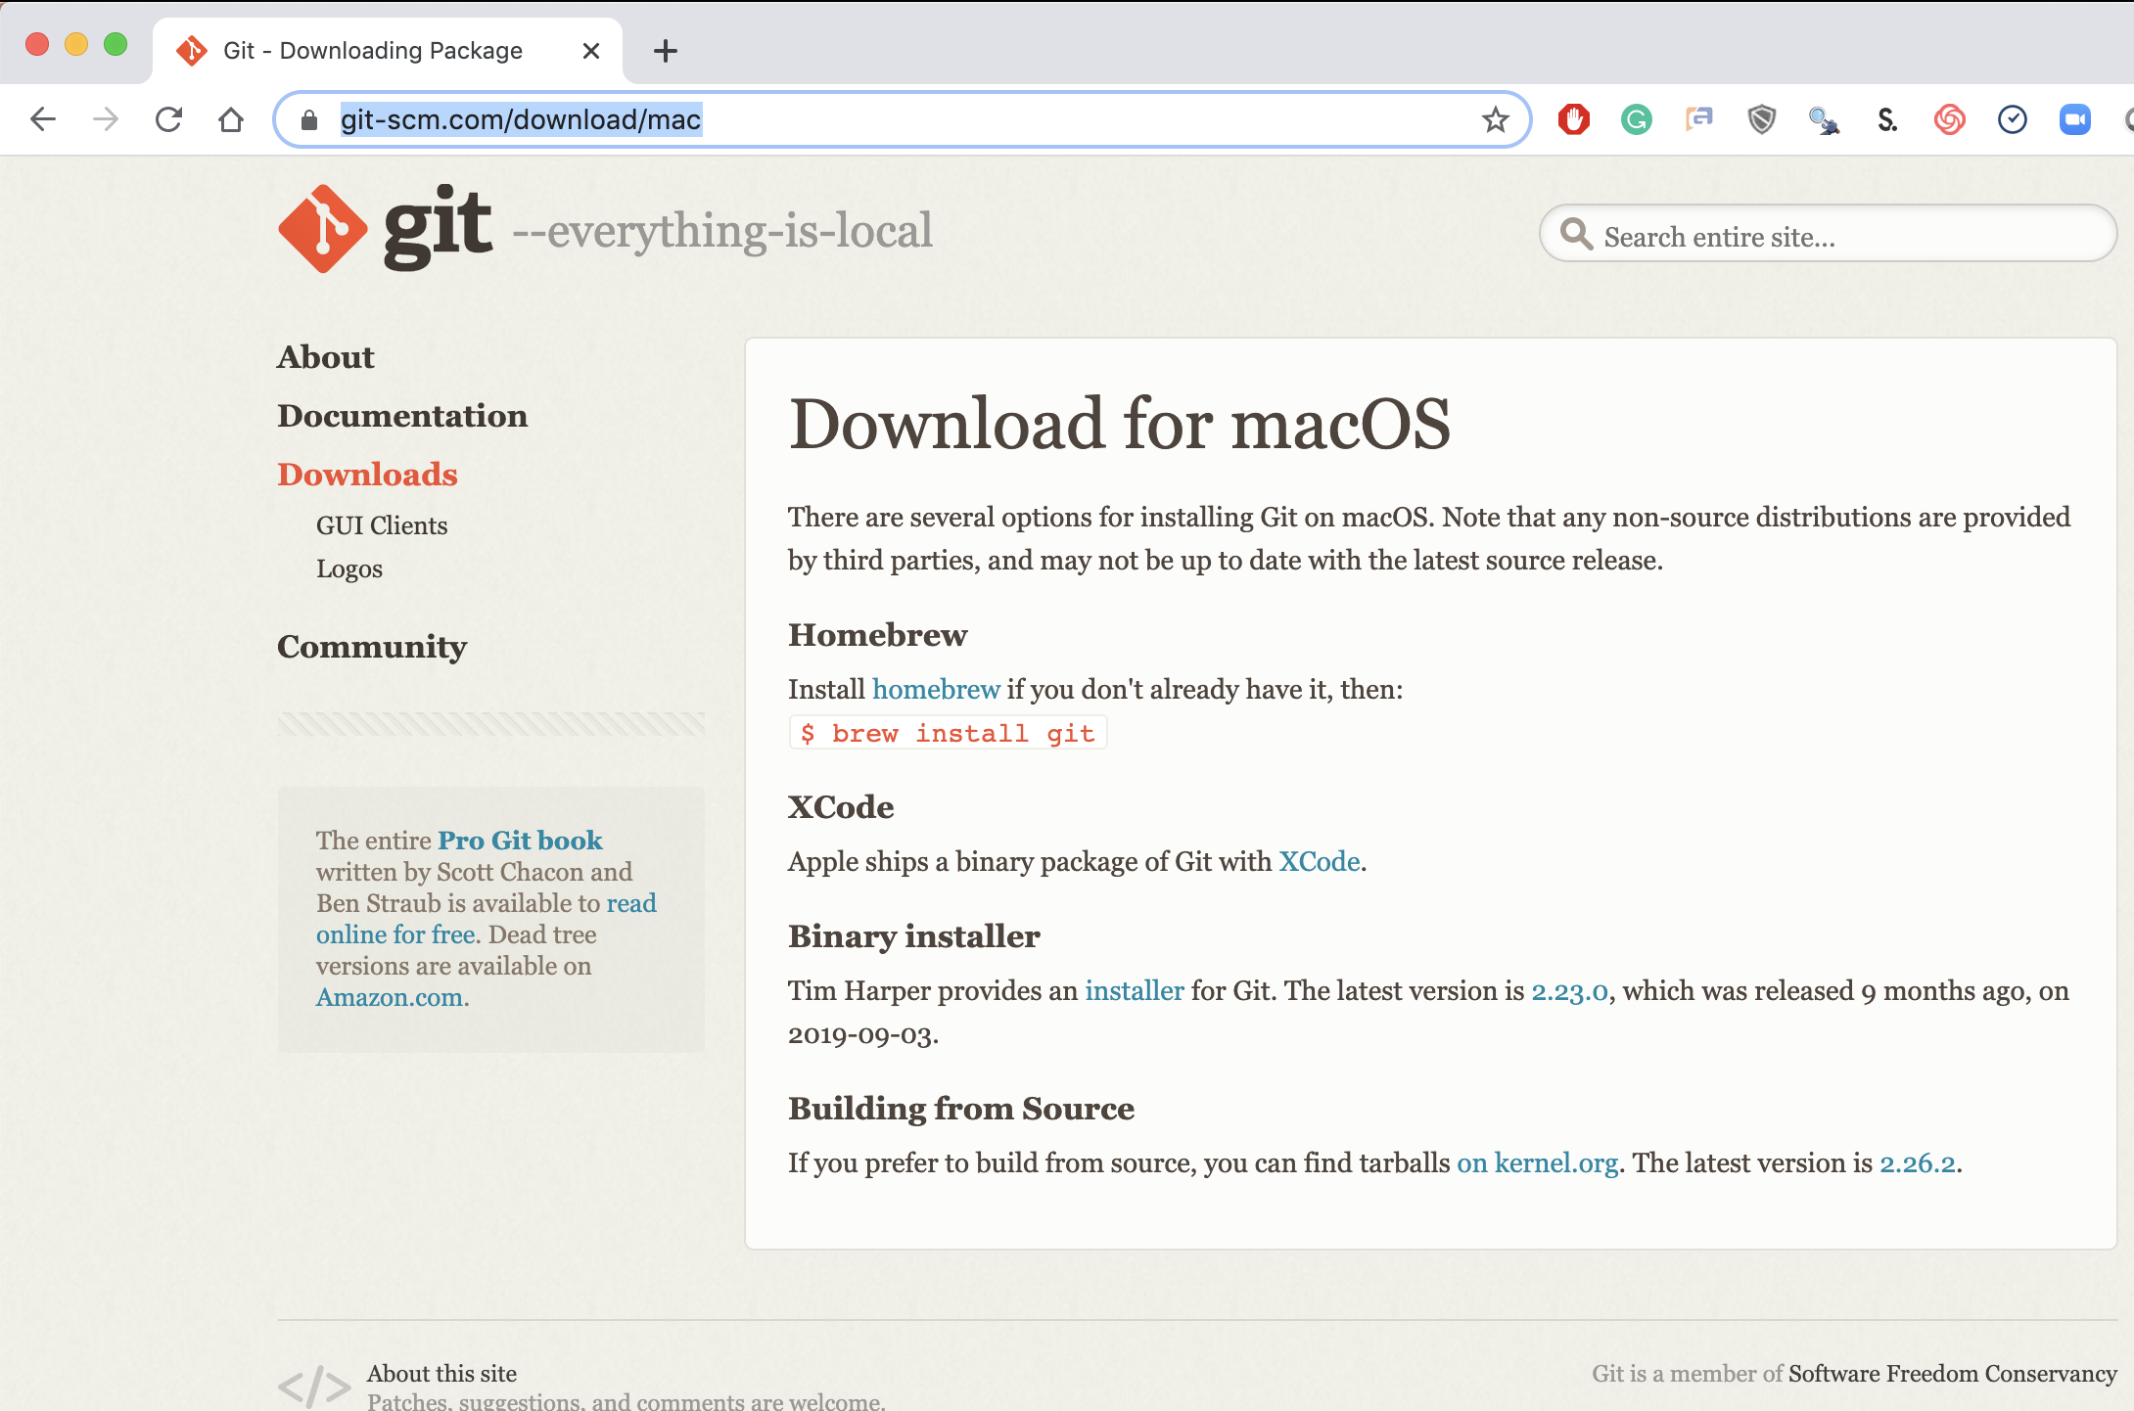
Step 3. Install Git (Mac)
Local Laptop Apple
Download the Git Program, then follow prompts for installation.
https://git-scm.com/download/mac &
https://www.youtube.com/watch?v=twFo9wCpdSU

Slide 8
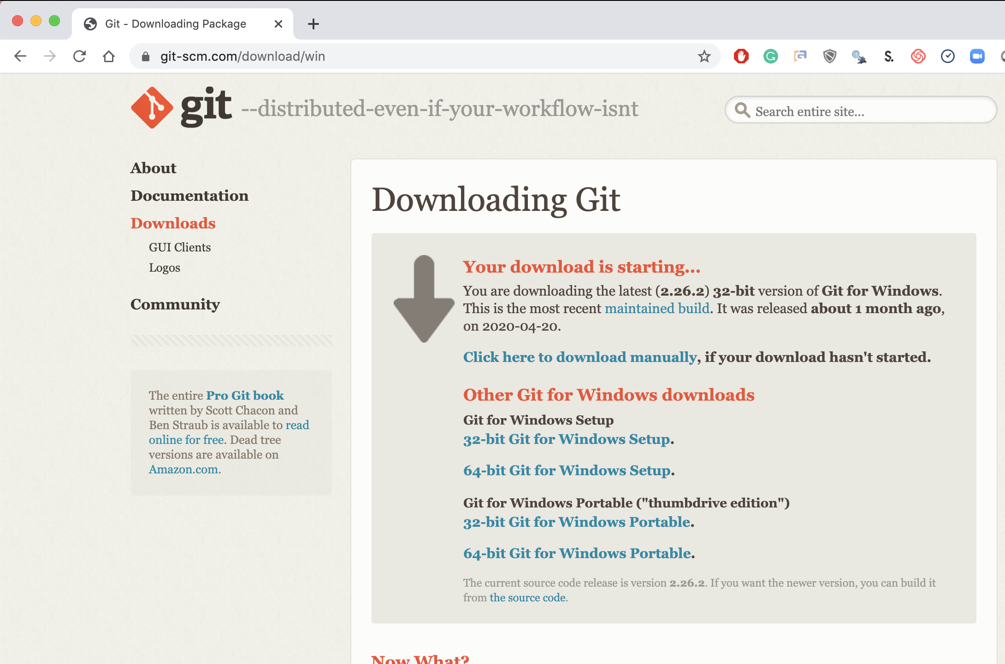
Step 3. Install Git (Windows)
Local Laptop MSFT
Download the Git Program, then follow prompts for installation.
https://git-scm.com/download/win &
https://www.youtube.com/watch?v=nbFwejIsHlY

Slide 9
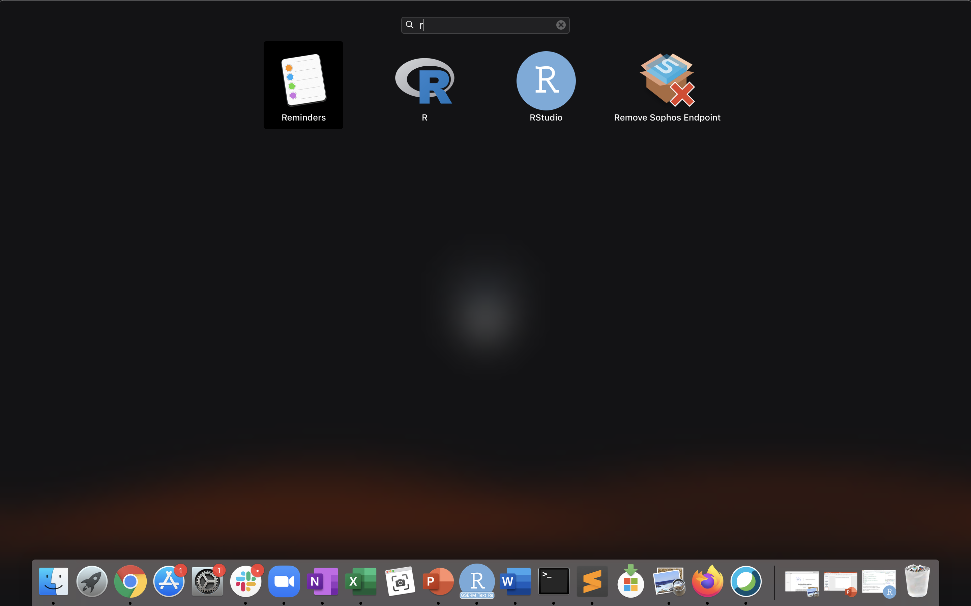
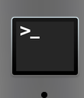
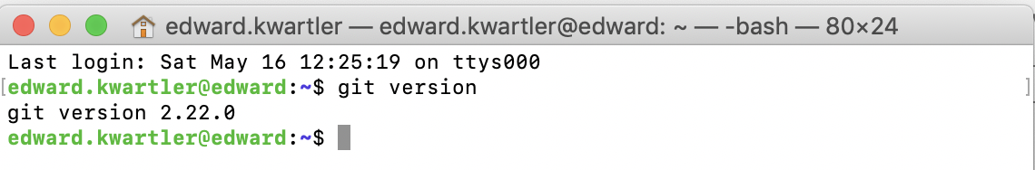
If you are working local you should now have R, R-Studio and git.
Mac: Use “Launchpad” & Type R
Mac: Use: “Terminal” & Type “git version”
Mac: Look for R and R-Studio Icons.

Slide 10
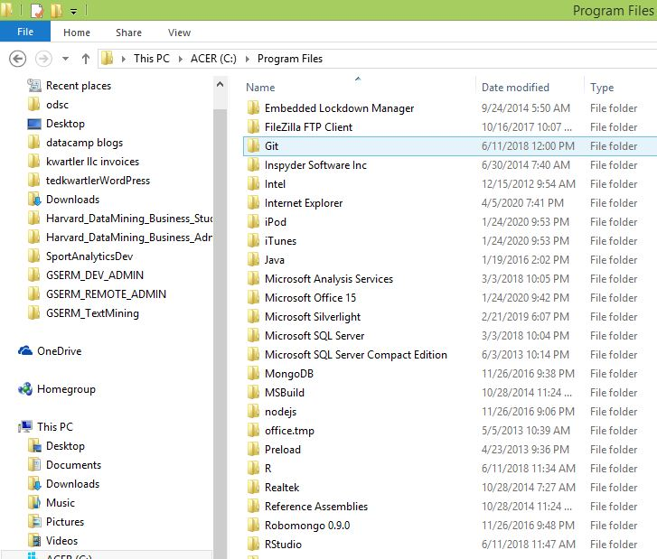
If you are working local you should now have R, R-Studio and git.
Windows: Navigate to the program folder look for git, R and R Studio

Slide 11
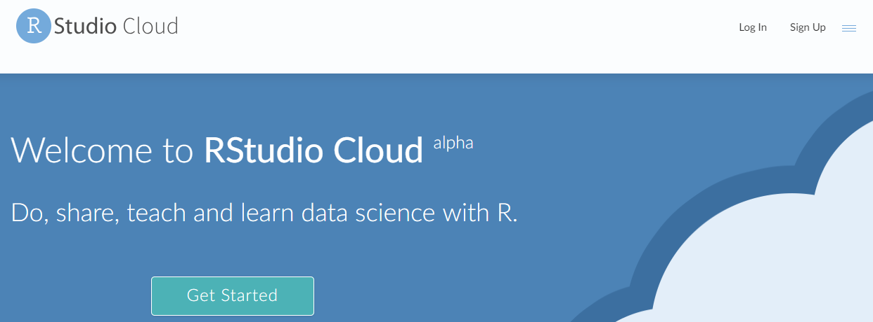
Last resort…free hosted cloud instance
Sign up at:
https://rstudio.cloud/
KEEP IN MIND IT IS TIME LIMITED FOR FREE

Slide 12
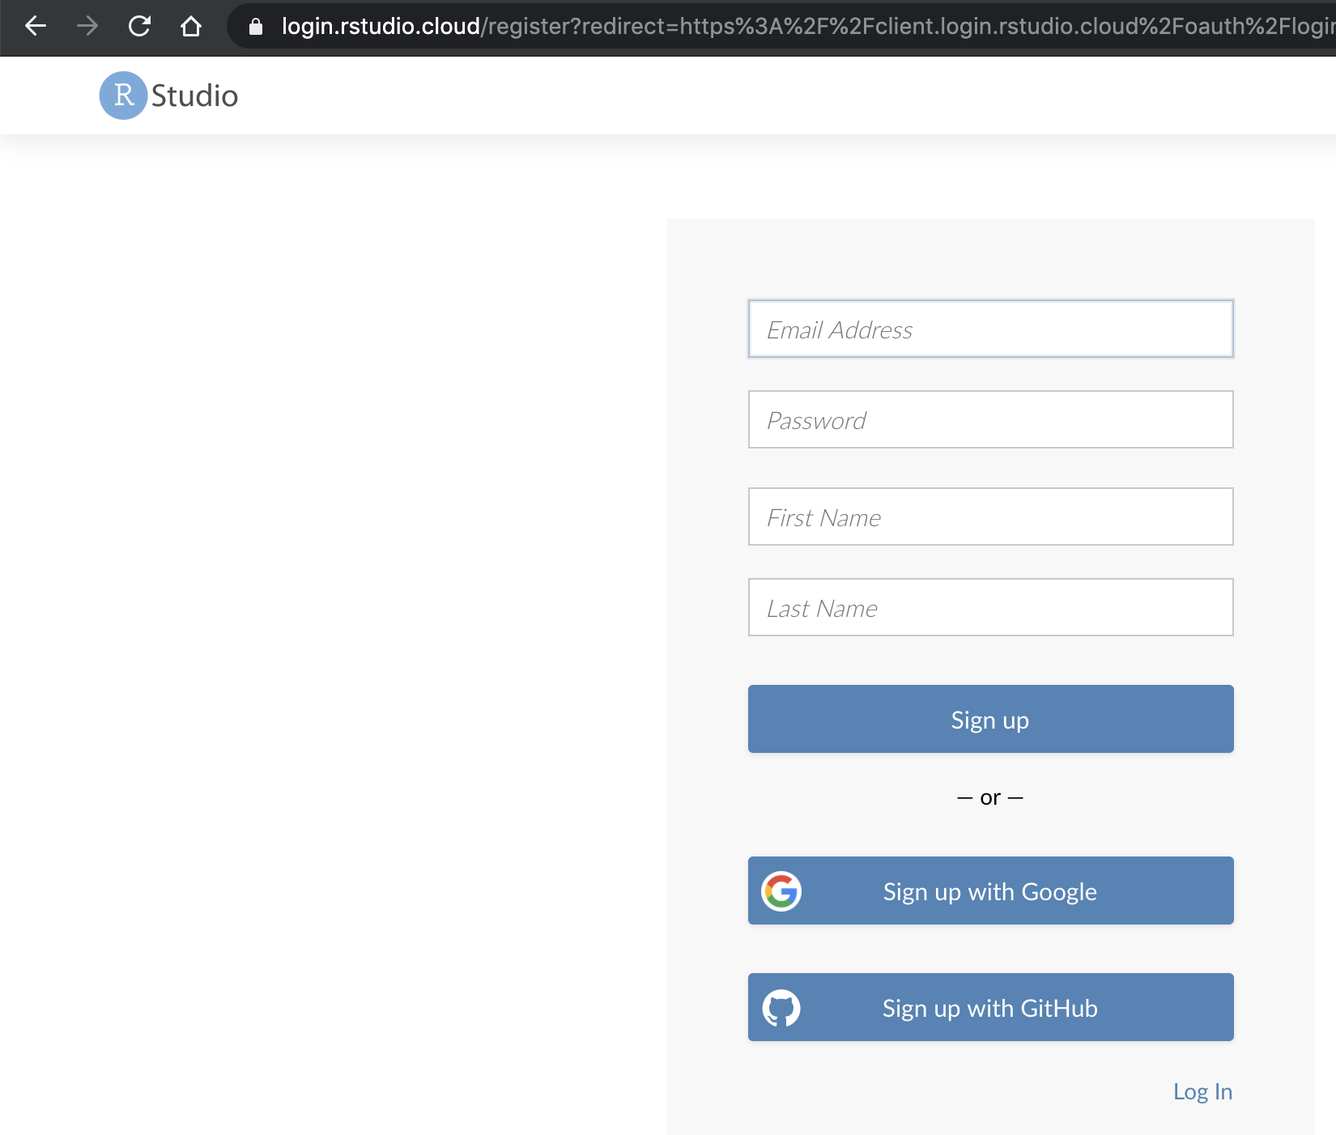
Steps 1, 2 & 3 are done for www.rstudio.cloud!
Cloud
Navigate to www.rstudio.cloud & sign-up!

Slide 13
Now that you have R, R-Studio & Git, time to connect to our class repository.
Connect to git repository.
R Studio sits on top of base R & adds functionality.
Class Files hosted on github.com
Makes the programmatic connection.

Slide 14
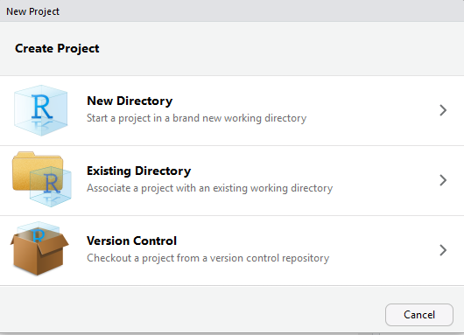
If LOCAL: setup a new project & do a “git pull”
https://github.com/kwartler/GSERM_Text_Remote_student
Open R Studio
File
New Project
Version Control

Slide 15
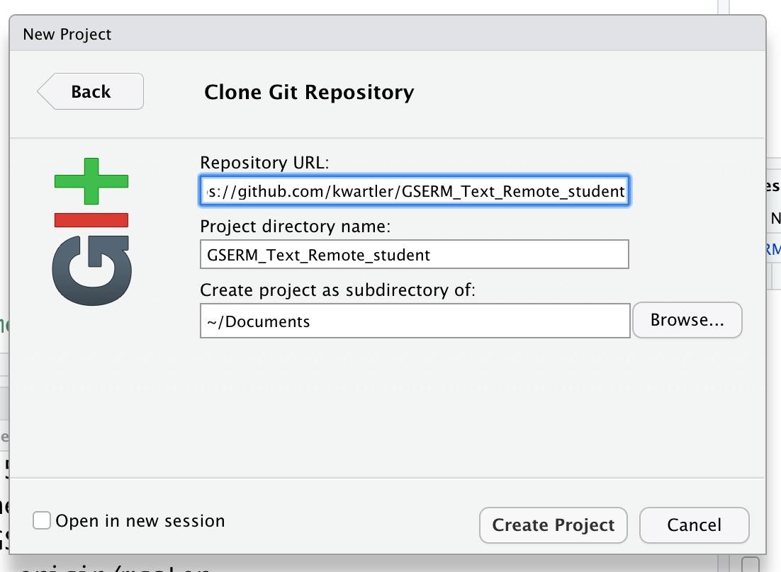
If LOCAL: setup a new project & do a “git pull”
https://github.com/kwartler/GSERM_Text_Remote_student
In R Studio
File
New Project…
Version Control
Select Git
Add URL, folder name & destination for files

Slide 16
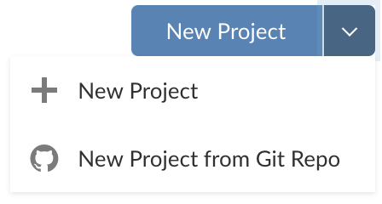
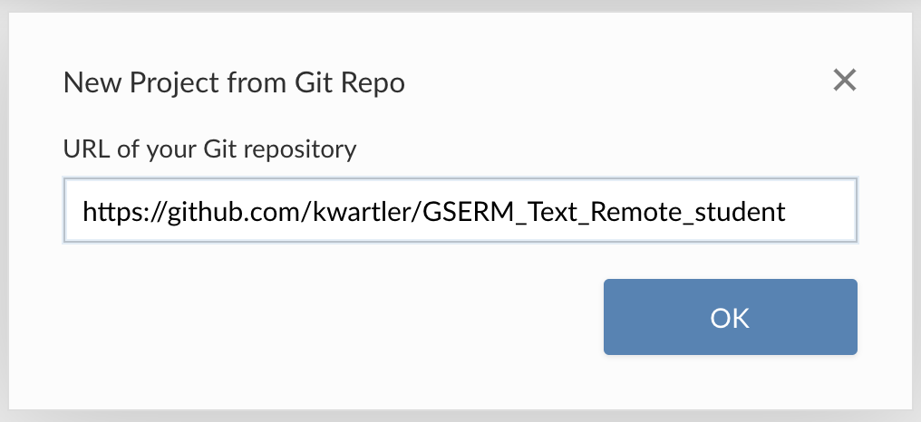
If you are using Rstudio.cloud
In the browser

Slide 17
Then rename your project in the browser
In the browser

Slide 18
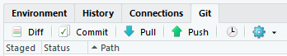
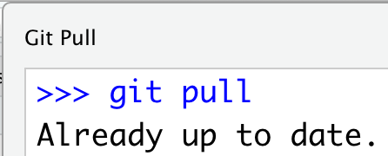
Each day we will perform a git pull.
https://github.com/kwartler/GSERM_Text_Remote_student
In R Studio
File
New Project…
Version Control
Select Git
Add URL, folder name & destination for files
EACH Class session perform a Git Pull to update files

Slide 19
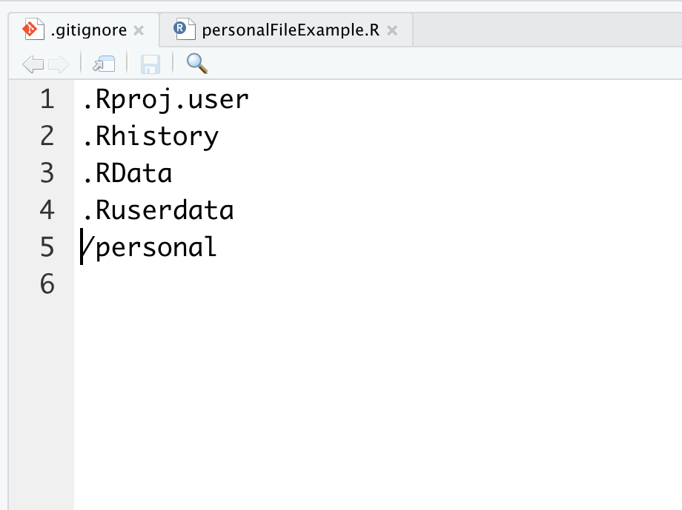
Second to last item. Create a personal folder.
Open the “gitignore” file. Add slash personal
Name of folder to be ignored “personal”
When you work and make changes to scripts, SAVE AS to a personal folder that is ignored by git.

Slide 20
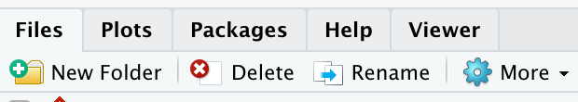
Second to last item. Create a personal folder.
In the lower right file section click “New Folder”. Name it “personal” exactly as in the gitignore (capitalization)
Click New Folder

Slide 21
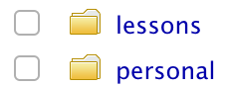
Second to last item. Create a personal folder.
In the lower right file section click “New Folder”. Name it “personal” exactly as in the gitignore (capitalization)
Any file you change should be “Save As” in this folder.

Slide 22
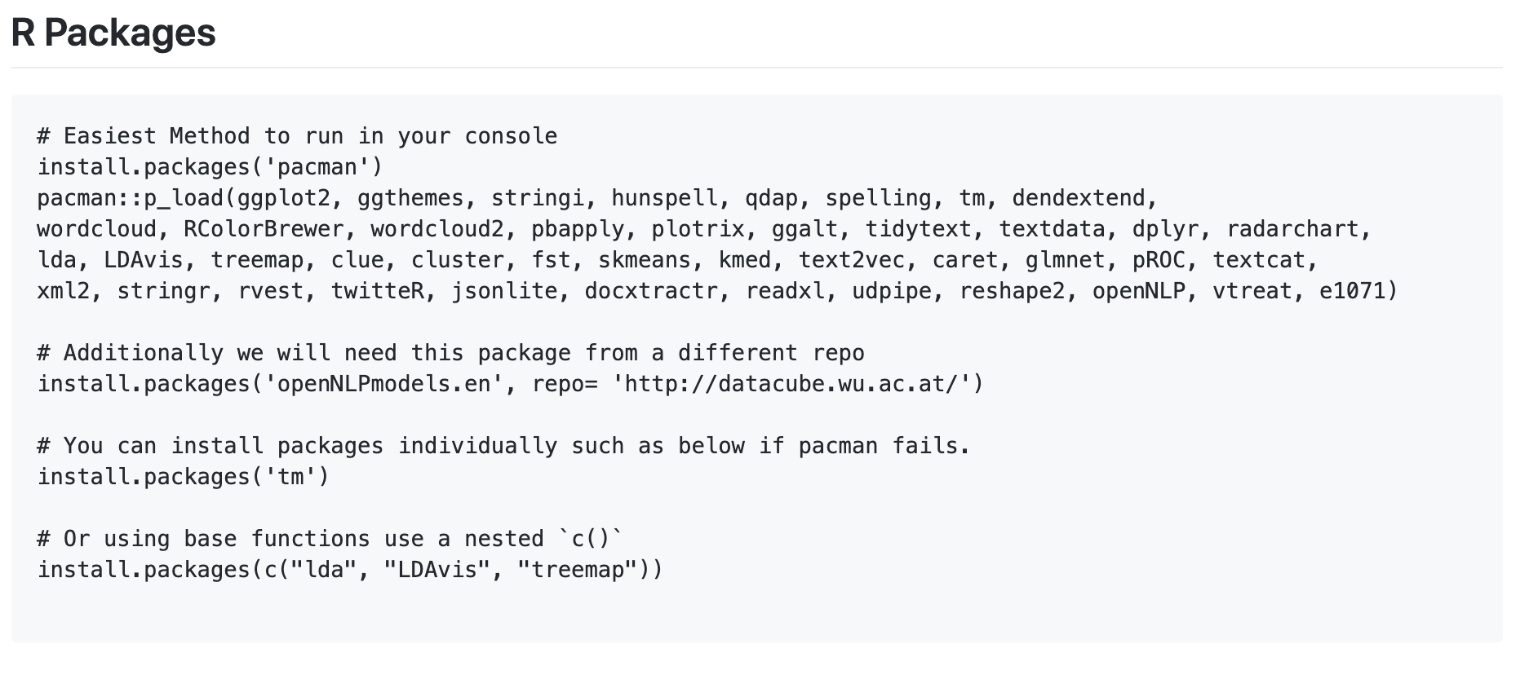
Now just run some code (we will explain it later)
https://github.com/kwartler/GSERM_Text_Remote_student
If you have R, Rstudio, Git, then made a connection and can run this code…you’re off to a great start! And don’t worry if you hit a hiccup, we will figure it out.

Slide 23
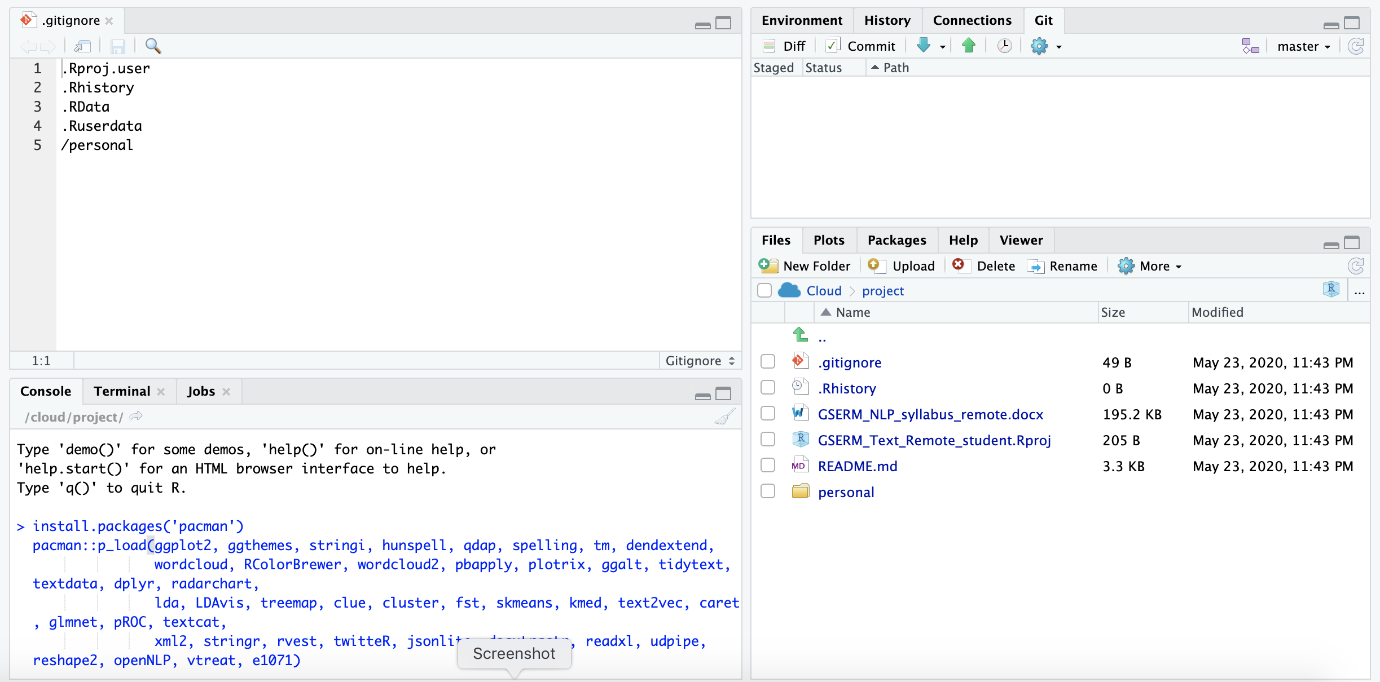
Now just run some code (we will explain it later)
Copy the first part of the code from the class repository. Then paste it into the “console” (lower left of your R session) & hit enter..
Do this step at a time when you don’t need your laptop or can just leave your browser open depending on your method of accessing the software.

Slide 24
Almost setup…don’t worry if you need help live.

